Slide 1
Welcome First Grade Parents
Miss Katelyn Shaughnessy

Slide 2
Curriculum
Subjects taught:
Language Arts
Math
Fundations

Slide 3
Language Arts
The first three weeks are a smart start
which is a review of kindergarten skills,
getting to know you activities, and getting back into
the school routine .
Tests are weekly ( Start when we get into unit 1 week 1)
Spelling tests(weekly)
Vocabulary🡪 high frequency words
Comprehension
Phonics
Peek at the Week papers will be in the back pocket of your child’s take home folder. This has all the material each week we are covering and it would be most helpful to look over each night to prepare for the tests which occur every approx. 6-7 days in ELA.
Games→ We will work on the wonders games in class and you can go back and review them at night on Amplify. You can click on the clever link and this will lead right the apps we use in school each day.

Slide 4
Fundations
A supplemental program geared towards improving phonics skills.
Introduces high frequency words and spelling patterns in words.
Interactive program where students use magnetic white boards to build words, write sentences, and read short passages.

Slide 5
Math
Piloting new curriculum: GO MATH
Daily assessments
Beginning of the year benchmark
Middle of the year benchmark
End of the year benchmark
Waggle is the online program that will go with our new curriculum. This is a great resource to practice math skills at home!

Slide 6
Homework
We will have homework. Homework will be written in their agendas and needs to be signed nightly. I usually do two/three things for homework or nightly routines to practice at home.
Review the “Peek at Our Week” and Weekly Phonics Skills in the back pocket of your take home folder each night with your child. Study spelling words!!! Tests will be announced days ahead of time in agenda and via remind.
Reading Homework- A story/reading, which will be in either their take home folder. Great to read together before bed :)
Math homework- which is usually a worksheet from the lesson that day.

Slide 8
Discipline
School-wide behavior program. PBIS
Students will receive points based on their behaviors each time they display characteristics of VIKES!
Students can save their points to use for the monthly reward or to use in my classroom store.
I will not take away points. They earned them!!
There is a parent app to download on your phone so you can follow your child’s points that they receive.Please make sure you do this because this is one way I will communicate what is going on in the classroom.
I also have Remind @misss2023 or email kshaughnessy@riversidesd.com you can reach out to me with any questions!
I will also post information on the google classroom throughout the year of activities and special events happening!

Slide 9
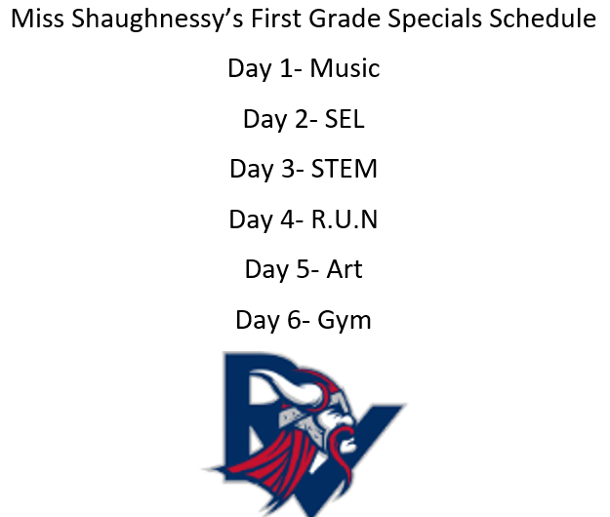
Schedule
Special schedule is in your child’s blue homework folder.

Slide 10
Thank You
Thank you for coming tonight and if you have any questions please feel free to call the school or reach me through any communication we discussed tonight.
My email address: kshaughnessy@riversidesd.com

